Slide 1
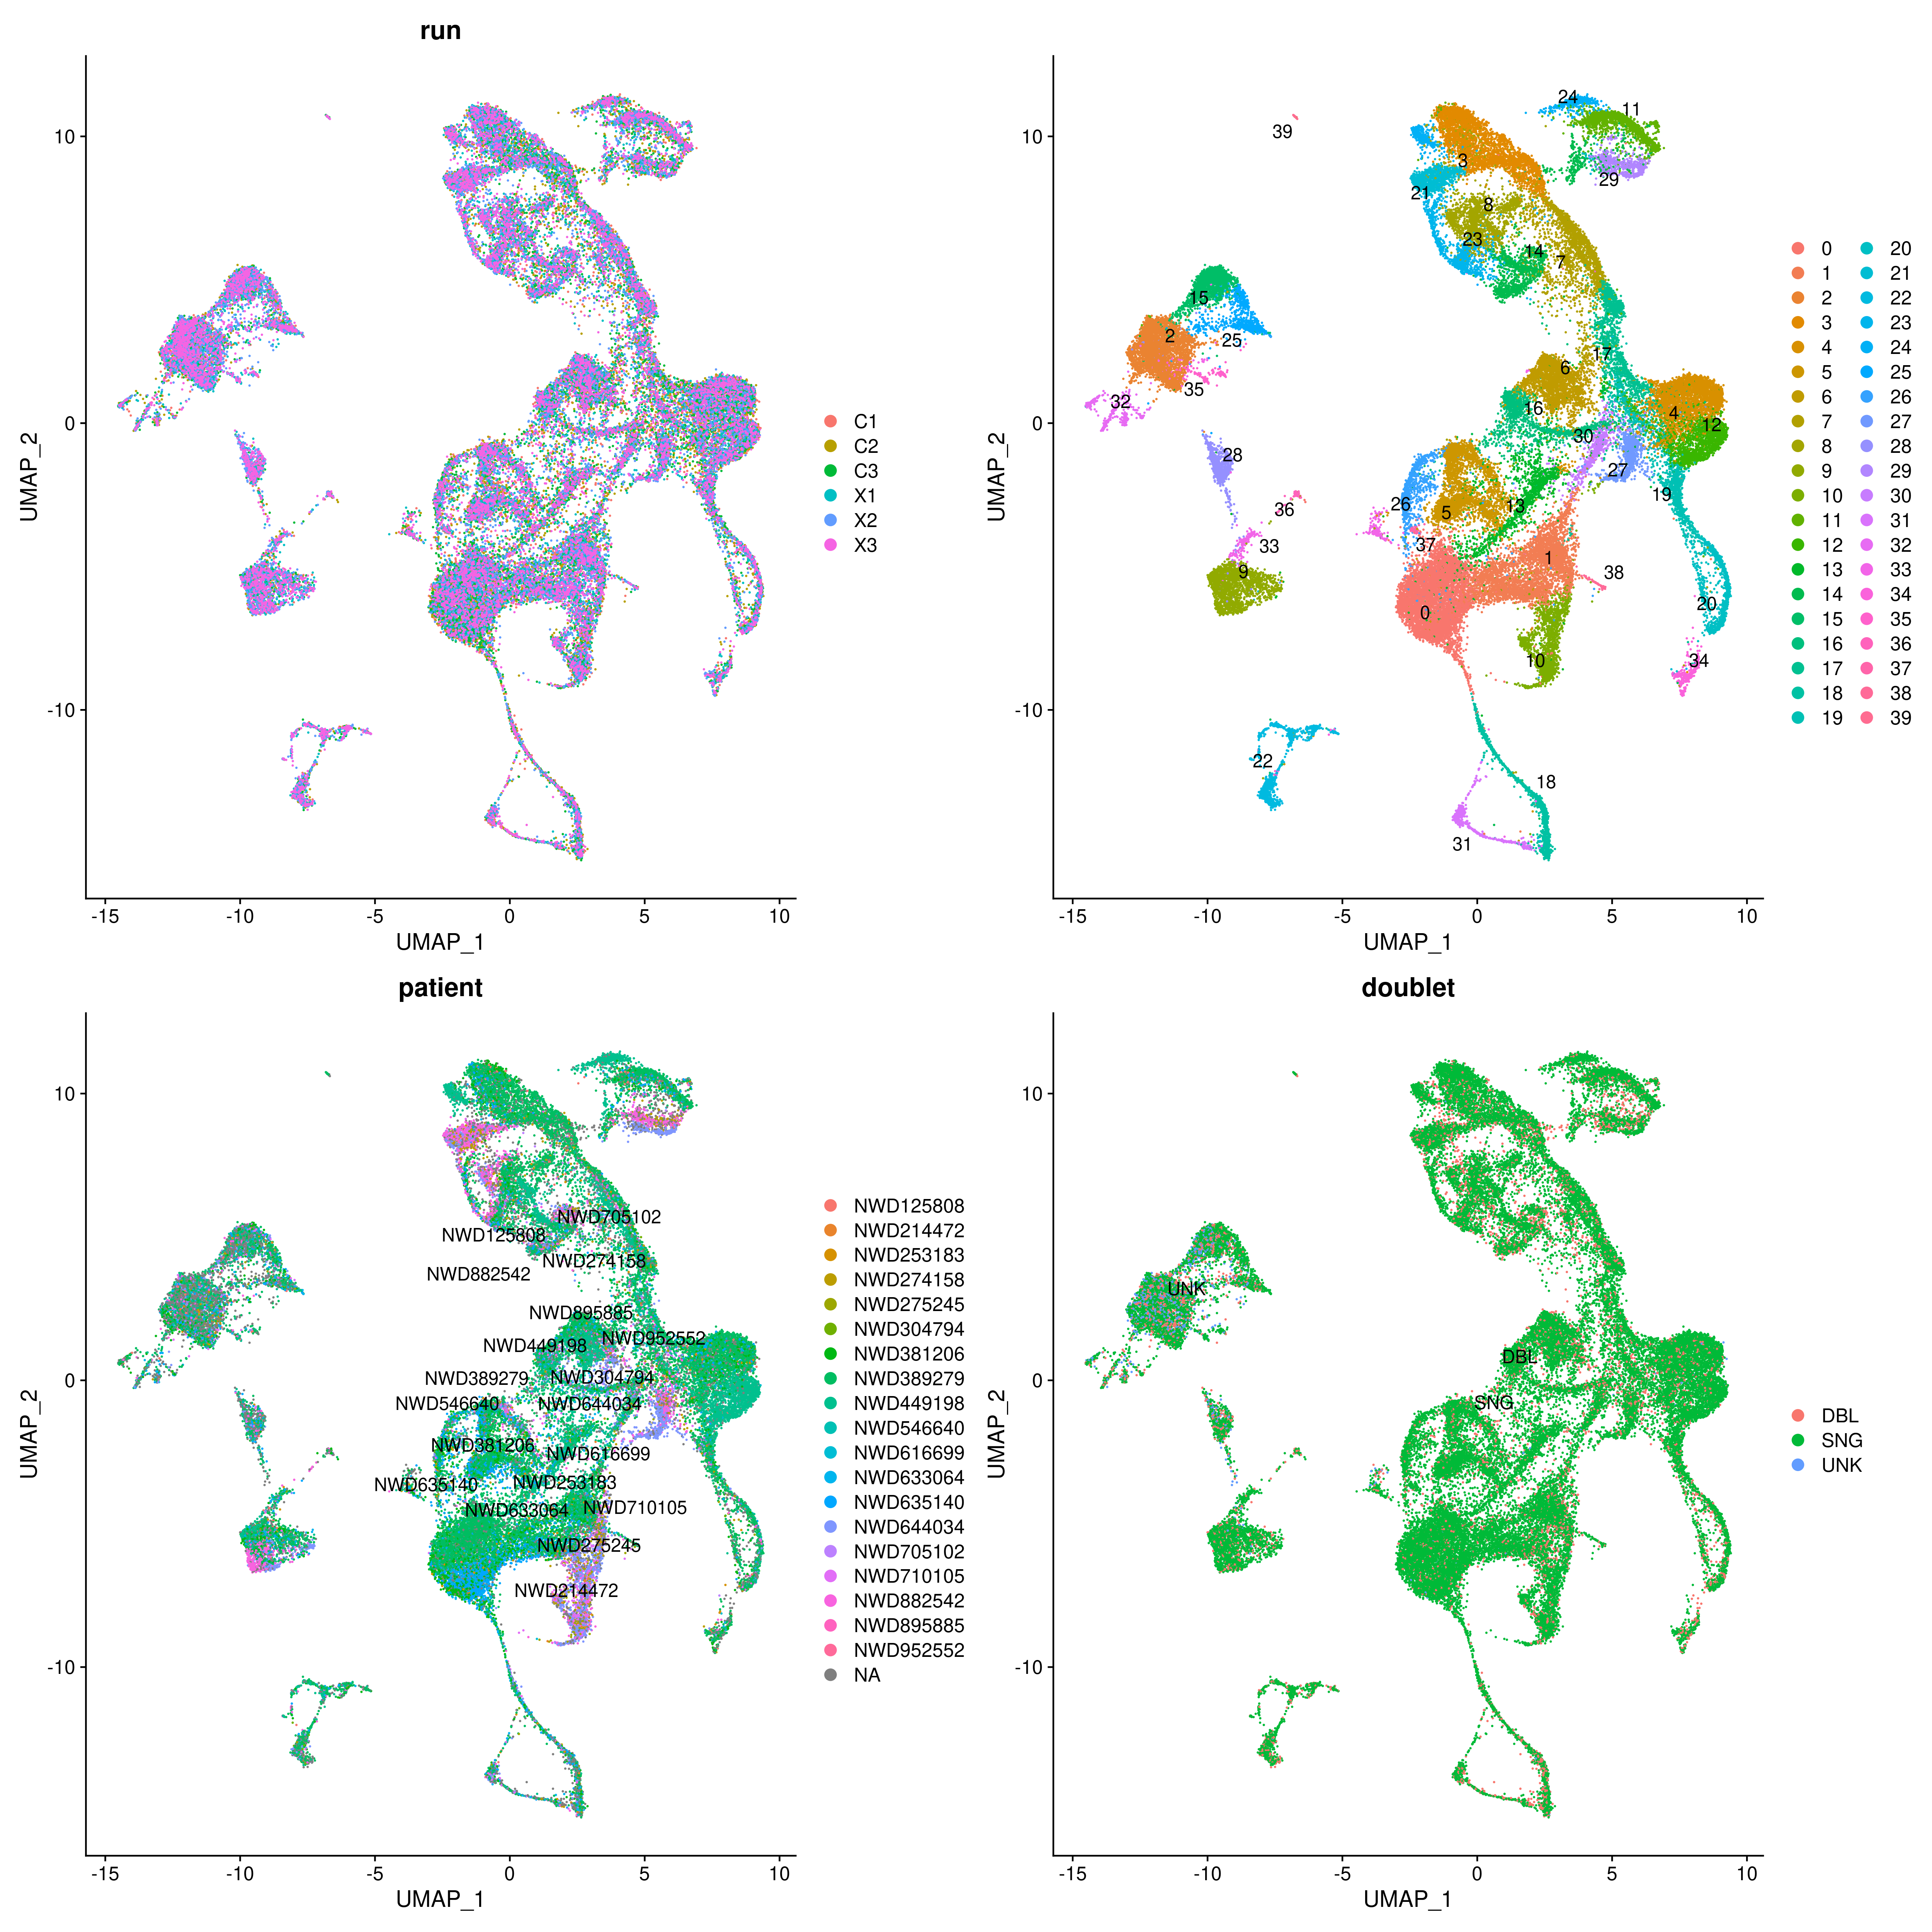


Computational analysis of Single-cell ATAC-seq data in R
Wilson Tan, PhD
Stanford University
@lekwen90
https://github.com/lwtan90/scATACseq_wilsontan

Slide 2
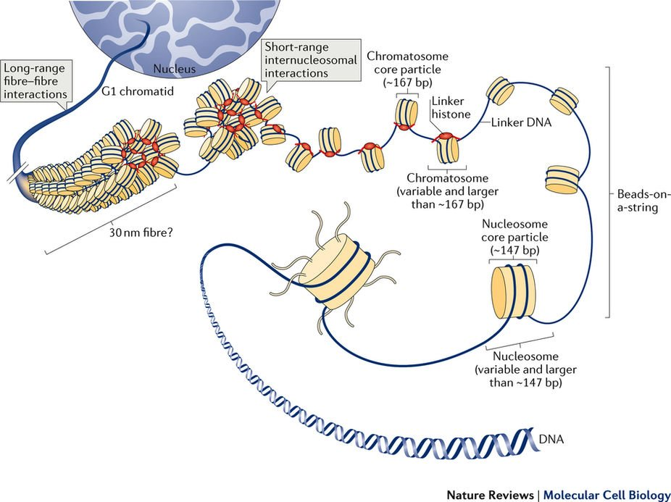
Importance of Chromatin Biology in Understanding Development and Diseases

Slide 3
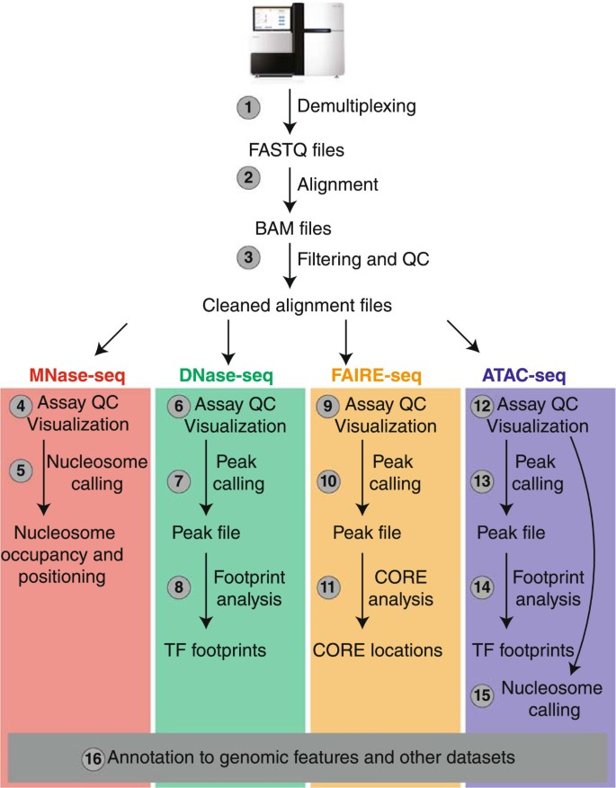
Conventional Ways of Investigating Chromatin Biology (Bulk Tissue Method)
Maria et al. Chromatin accessibility: a window into the genome. Epigenetics & Chromatin (2017)

Slide 4
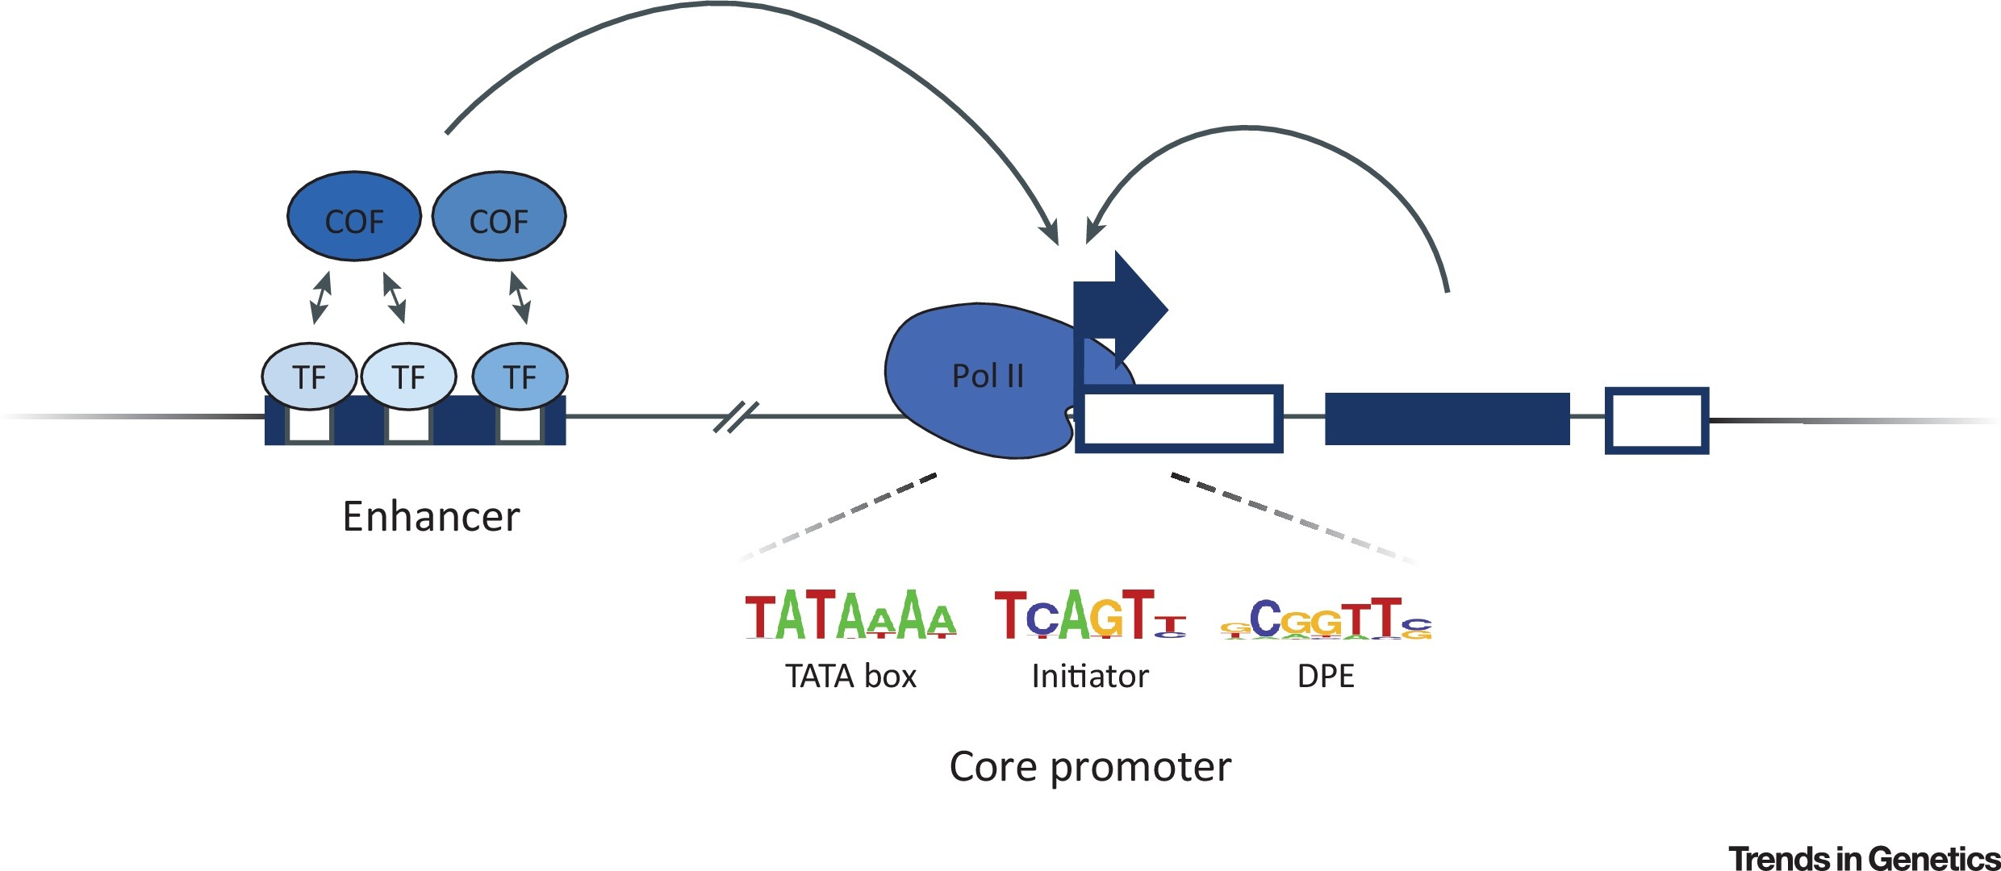
Experimental Procedure for Single-cell ATAC-seq

Slide 5
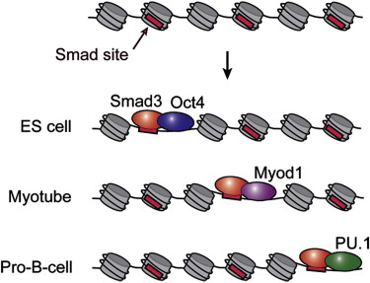
Cell-Type specific Transcription Factor binding and Regulation
Mullen et al. Master Transcription Factors Determine Cell-Type-Specific Responses to TGF-β Signaling. Cell (2011)

Slide 6
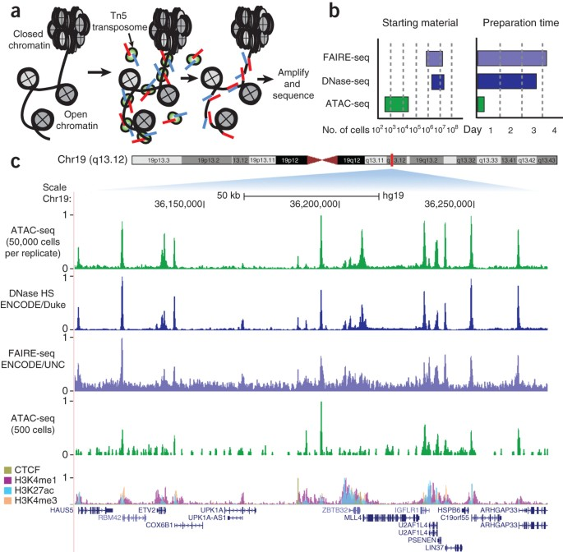
Conventional Ways of Investigating Chromatin Biology (Bulk Tissue Method)
10x Genomics

Slide 7
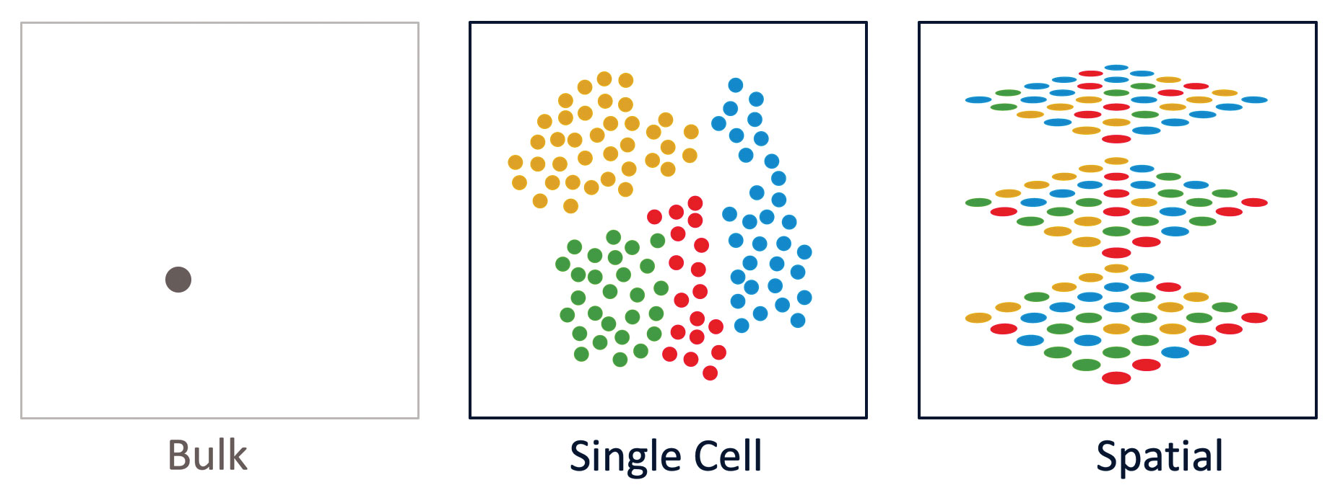
Conventional Ways of Investigating Chromatin Biology (Bulk Tissue Method)
10x Genomics

Slide 8
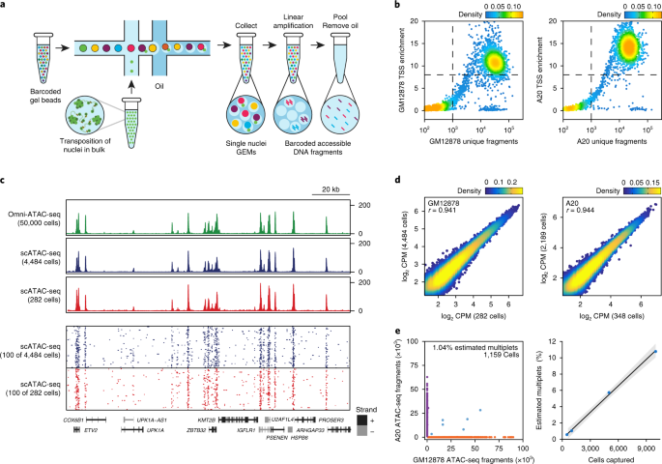
Experimental Procedure for Single-cell ATAC-seq
Satpathy et al. Massively parallel single-cell chromatin landscapes of human immune cell development and intratumoral T cell exhaustion Cell (2019)

Slide 9
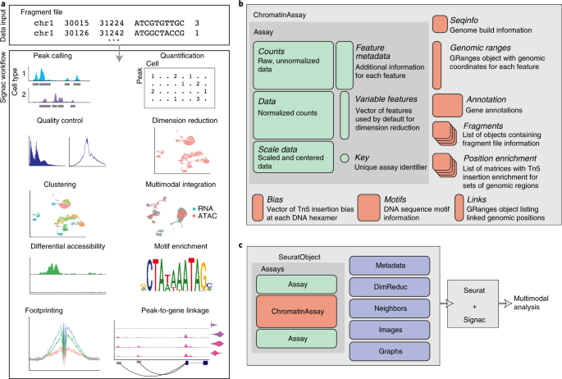
Bioinformatics Analysis of Single-cell ATAC-seq
Downstream Analysis
(Signac / SnapATAC / etc)
FASTQ FILES
Cellranger-atac
Alignment and Counts

Slide 10

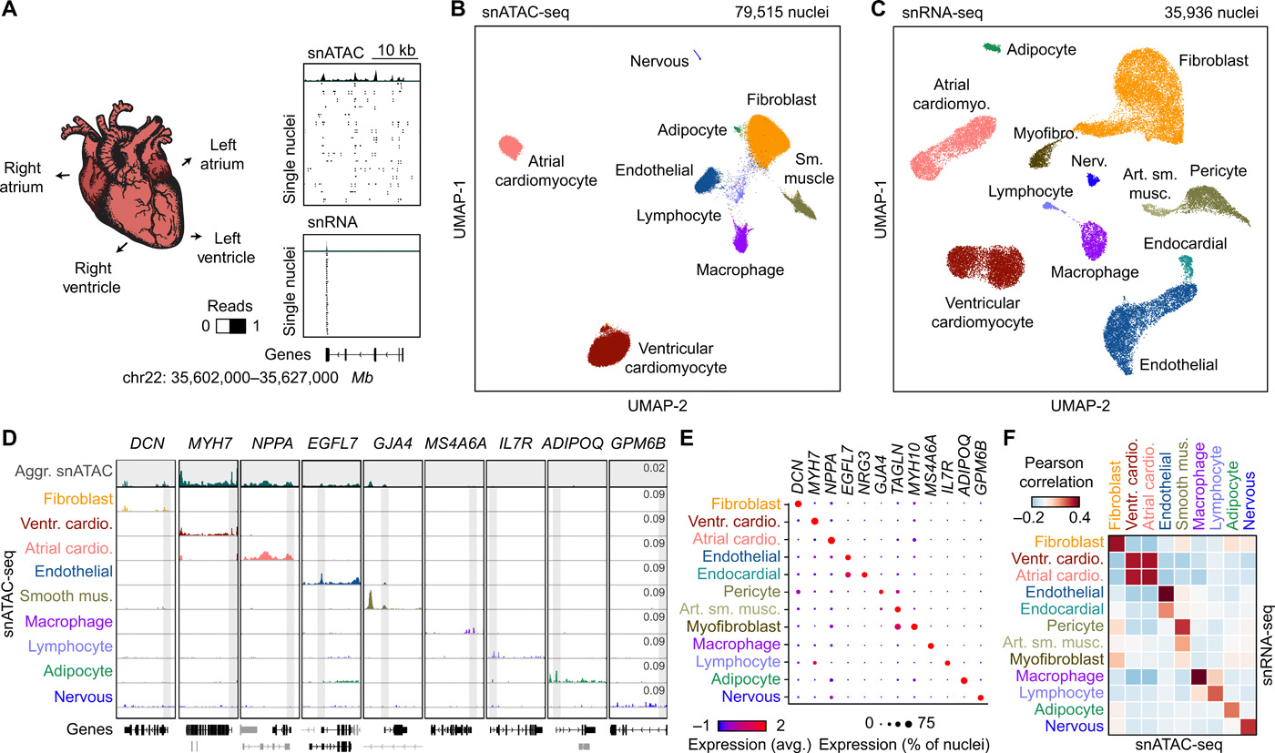
Bioinformatics Analysis of Single-cell ATAC-seq

Slide 11
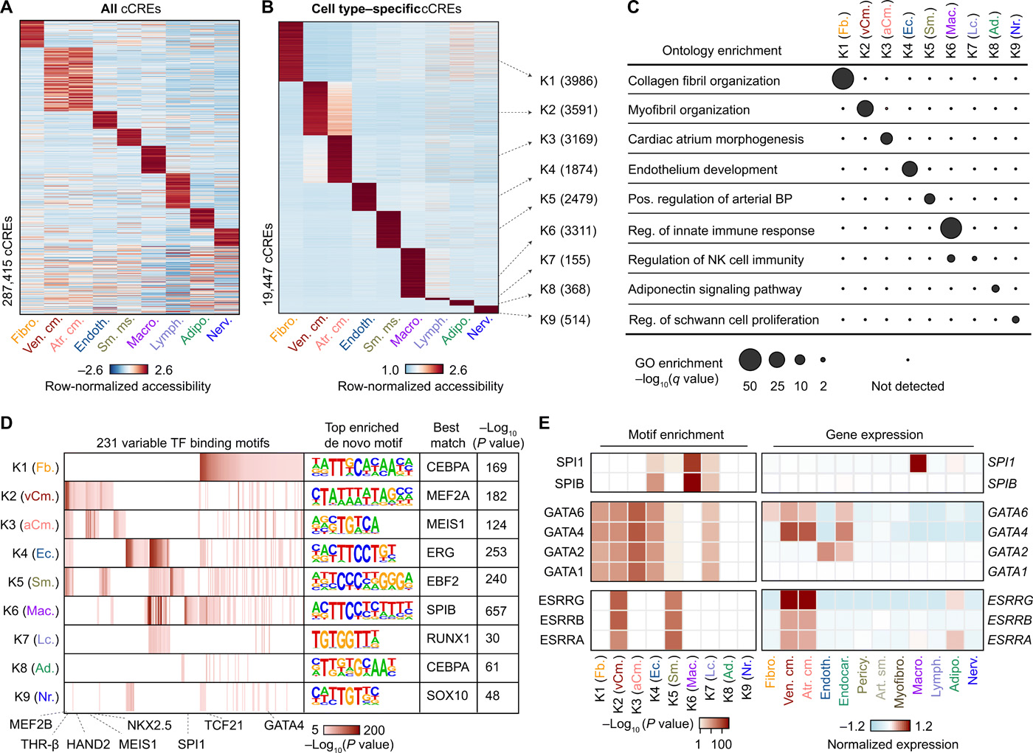
Hands-on Analysis of Single-cell ATAC-seq

Slide 12
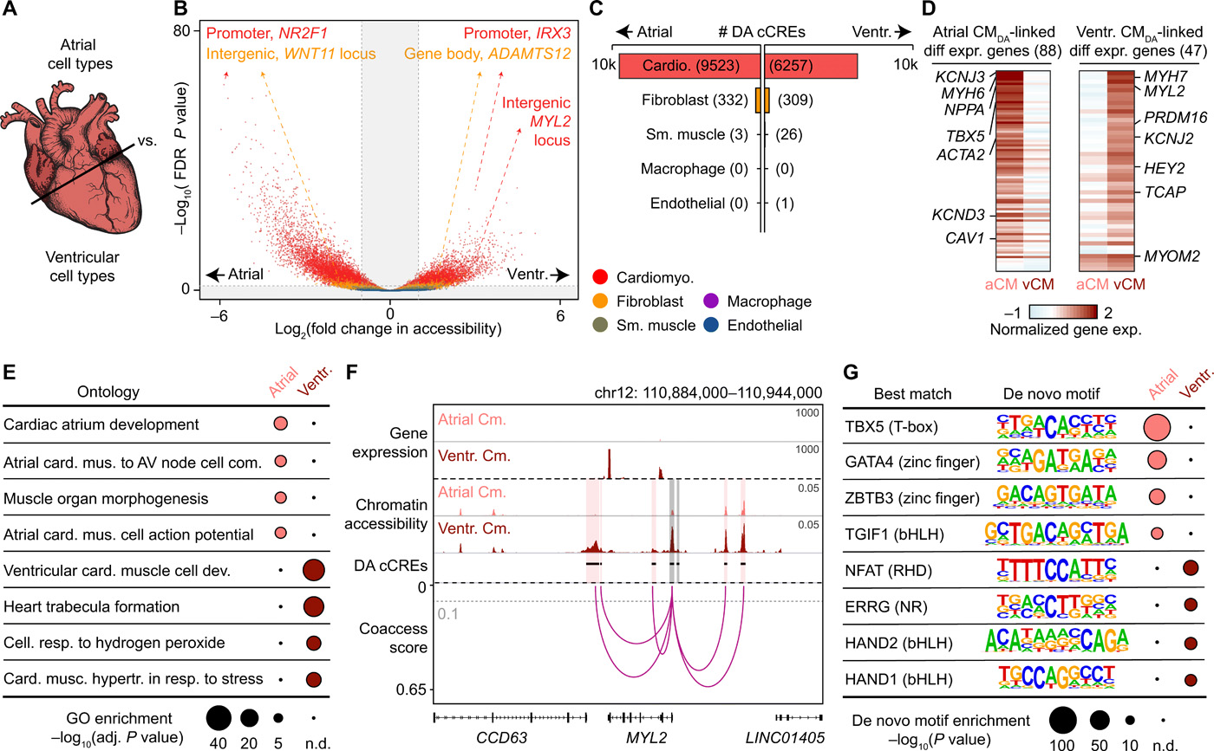
Hands-on Analysis of Single-cell ATAC-seq

Slide 13
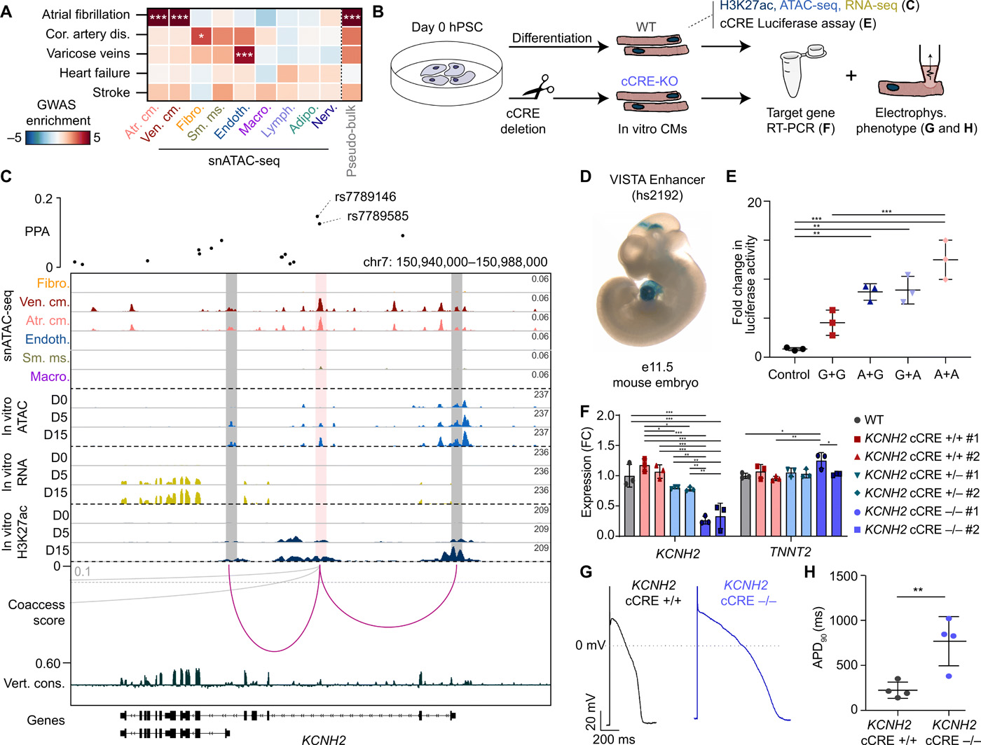
Hands-on Analysis of Single-cell ATAC-seq

Slide 14
What you will get out from these 2 sessions:
Basic understanding of single-cell Chromatin Biology
Understand the steps in processing single-cell chromatin sequencing data
Interpretation of single-cell chromatin figures
What you will NOT get out from these 2 sessions:
Expert in single-cell analysis because it requires you to practice on real world data A LOT!
Expert in R programming (You need a lot of practice)
However, I hope you can ask me any questions during the hands-on session:
I might not know the answer, but I would love to learn your prespective ☺
Data source: https://www.ncbi.nlm.nih.gov/geo/query/acc.cgi?acc=GSE165837

